Slide 1

Exploratory Data Analysis On AMCAT Dataset

Slide 2

About me
Name : Patlolla Pranavkumar
Qualification : M.SC (Statistics)
Work Experience : Fresher
linkedin : www.linkedin.com/in/patlolla-pranav-kumar
Github: https://github.com/PranavKumarPatlolla/AMCAT-Project

Slide 3
Objective:
Explore the dataset to identify the key factors that Significantly affect the
salary levels among the job seekers. That Includes factors such as education, skills, location, experience.
Key Objectives:
Identifying the trends or patterns in salary distributions across different job designations and cities.
correlation among the key factors such as education, gender, designation, skills, experience and personal characteristics which effects salary.
Make some claims and try to prove through Statistical methods.

Slide 4
Data Description:
The dataset was released by Aspiring Minds from the Aspiring Mind Employment Outcome 2015 (AMEO). The study is primarily limited only to students with engineering disciplines. The dataset contains the employment outcomes of engineering graduates as dependent variables (Salary, Job Titles, and Job Locations) along with the standardized scores from three different areas – cognitive skills, technical skills and personality skills. The dataset also contains demographic features. The dataset contains around 40 independent variables and 4000 data points. The independent variables are both continuous and categorical in nature. The dataset contains a unique identifier for each candidate.
ID: Candidate ID
Salary: Salary of the candidate
DOJ: Date of joining the job
DOL: Date of leaving the job
Designation: Job designation/title
JobCity: City where the job is located
Gender: Gender of the candidate
DOB: Date of birth of the candidate
10percentage: Percentage score in 10th grade
12percentage: Percentage score in 12th grade
CollegeID: College ID of the candidate
CollegeTier: Tier of the college
Degree: Degree pursued by the candidate
CollegeGPA: Grade Point Average in college
CollegeCityID: ID of the college city
CollegeCityTier: Tier of the college city
CollegeState: State where the college is located
GraduationYear: Year of graduation
Domain: Domain knowledge score
ComputerProgramming: Score in computer programming
ElectronicsAndSemicon: Score in electronics and semiconductors

Slide 5
ComputerScience: Score in computer science
MechanicalEngg: Score in mechanical engineering
ElectricalEngg: Score in electrical engineering
TelecomEngg: Score in telecommunications engineering
CivilEngg: Score in civil engineering
Conscientiousness
Agreeableness
Extraversion
Neuroticism
Openness_to_experience: Personality trait scores

Slide 6
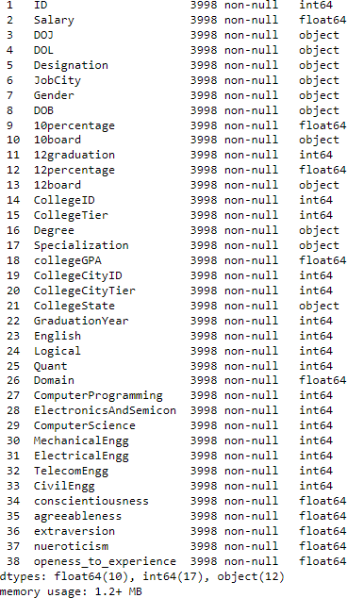
Information of Dataset
The Dataset contains 3998
records(rows).
38 features(columns)
25 features are numerical
10 features are categorical
3 features are datetime

Slide 7
Data Cleaning and Manipulation:
We can see the DOJ,DOL,DOB are given in timestamp format.
Job city column contains -1 values which are NaN equivalents. Replaced with most frequent city
names based different columns and checking spellings of city names.
10 board and 12 board columns contain 0 value which is missing value. Filled with mean of that specific column.
Dropped the columns which are having more 80% of null values.
Collapsed and mapping the categorical columns with specific values.
Performed Feature Engineering and created new columns from the existing data.
Performed Statistical Analysis using CDF and plotted the graphs.

Slide 8
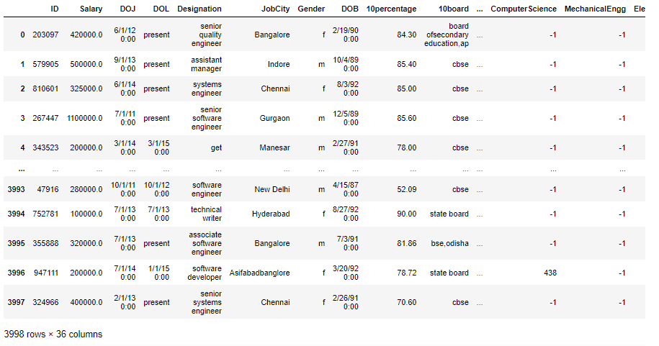
Data Cleaning :-
We deleted the Un wanted Columns Unnamed, CollegeID, College cityID

Slide 9
Univariate Analysis
Univariant Analysis means analysis of single variable. Here we used
1 . Histogram
2. Count Plot
QQ Plot
Bar Plot
Pie Chart

Slide 10
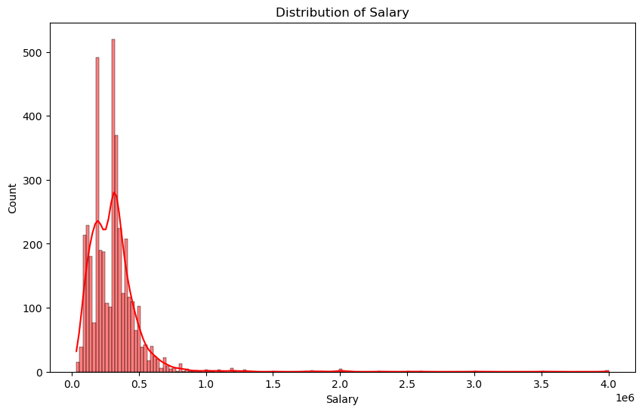
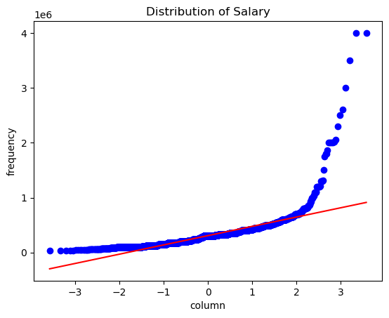
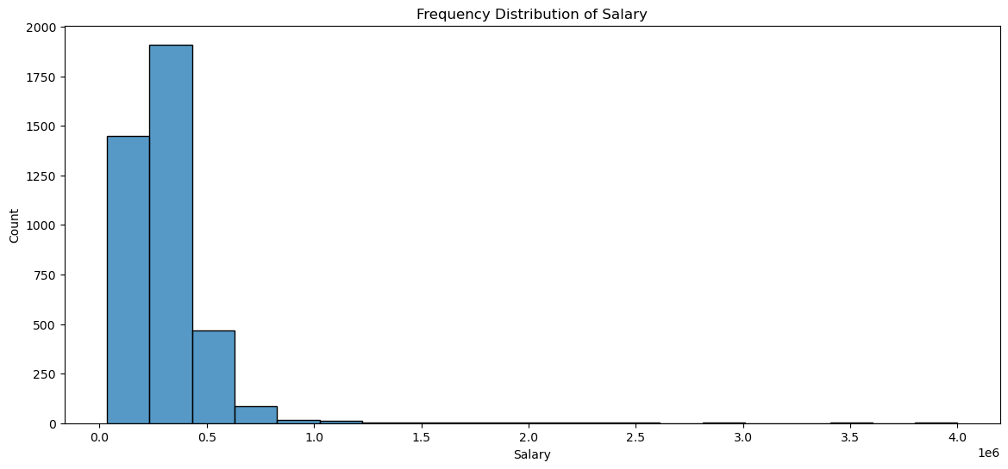
Observations :-
Salary : Distribution is right skewed and there is very less outlier data .

Slide 11
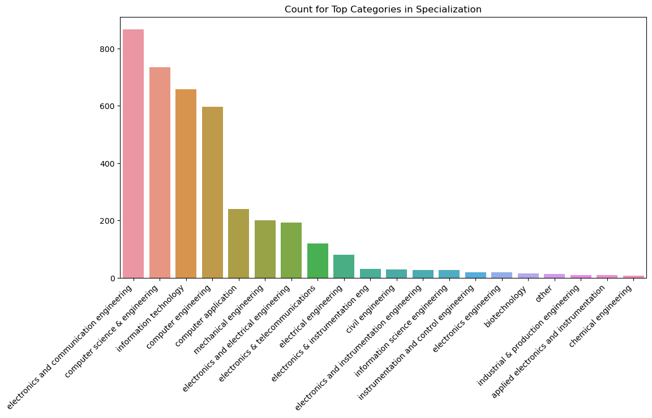
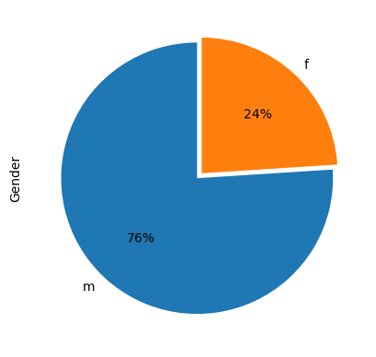
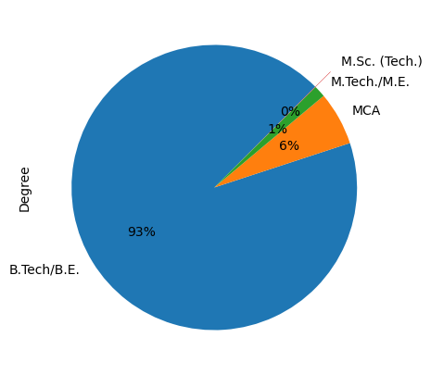

Slide 12
Observations : -
In Gender Column Male(76%) aspirants are compared to females(24%).
In Degree column mostly people took B.Tech/B.E (93%) as there degree followed by MCA(6%) ,Mtech(1%) and MSC(0%).
In specialization most of them took electronics and communication engineering followed by computer science and information technology and then computer engineering
Most of peoples college state is Uttar Pradesh

Slide 13
Bi-Variate Analysis
Bivariate analysis means the analysis of bivariate data. It usually involves the variables X and Y. Here we used target variable as y and we varied x axis
1 . Swam Plot
Scatter Plot
Box Plot
Bar Plot

Slide 14
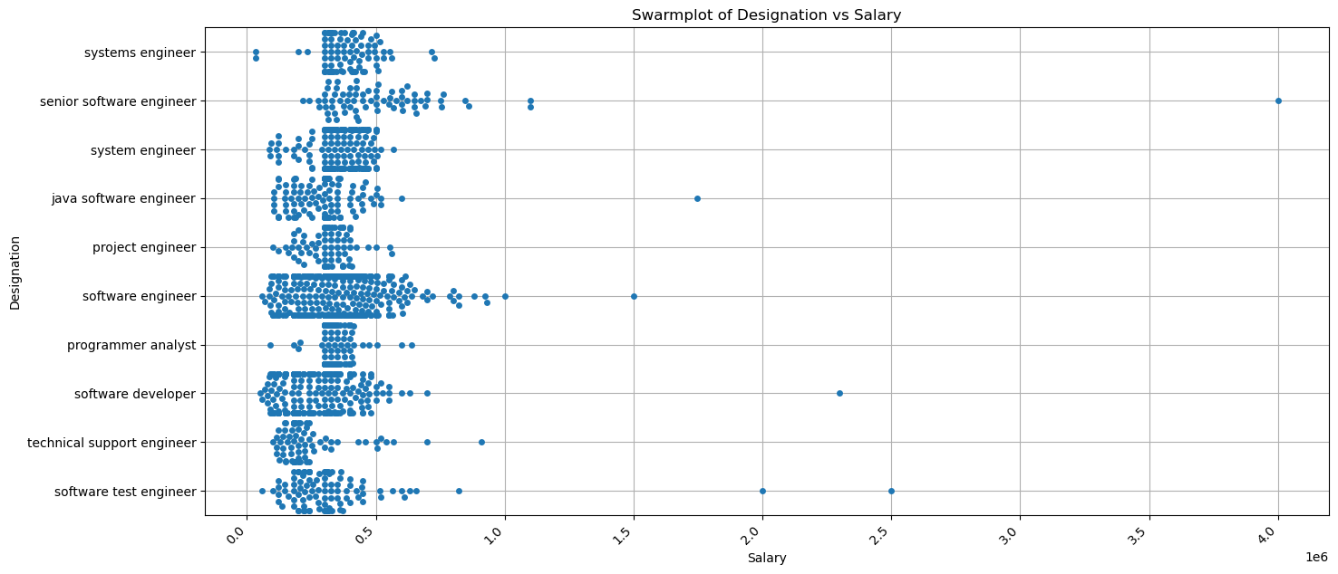

Slide 15
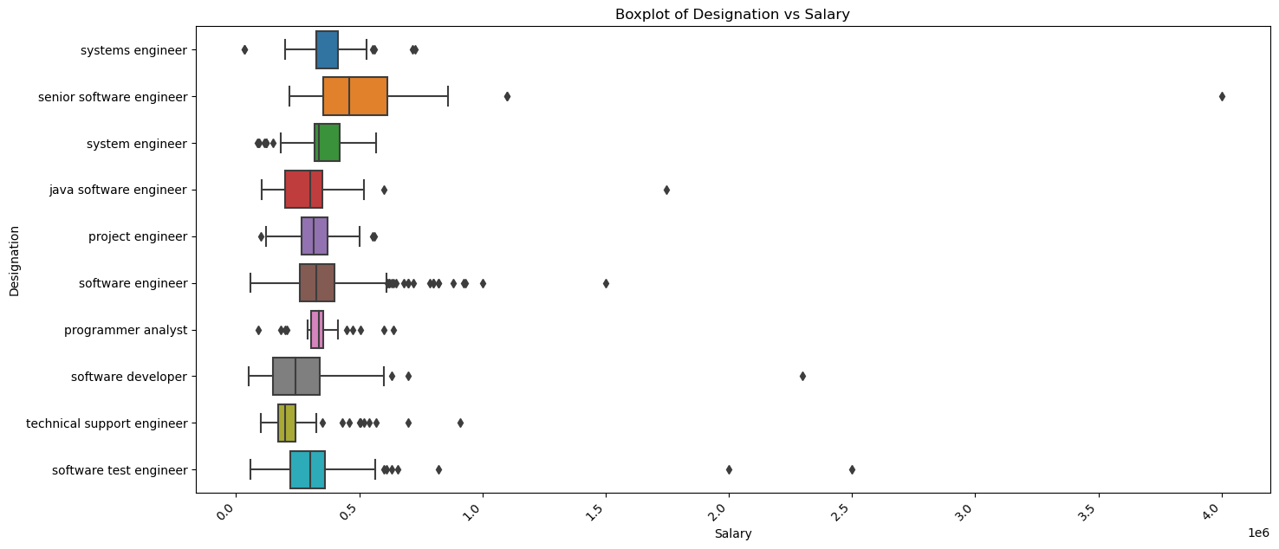

Slide 16
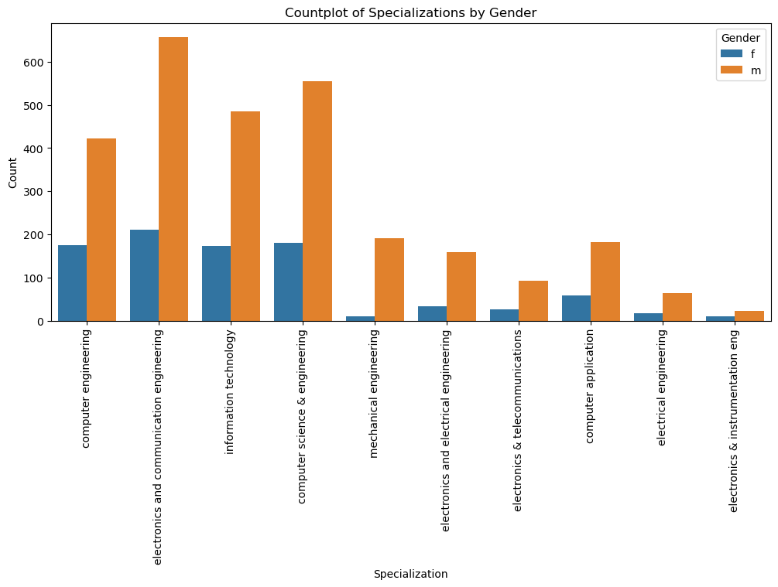
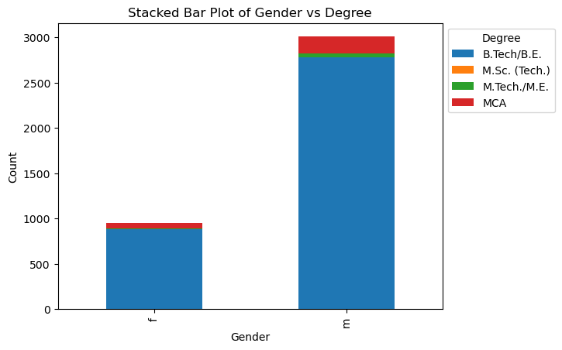
Observations :-
In all the specializations Male students are more than Female
In both genders most of the students are from B.Tech followed by MCA

Slide 17
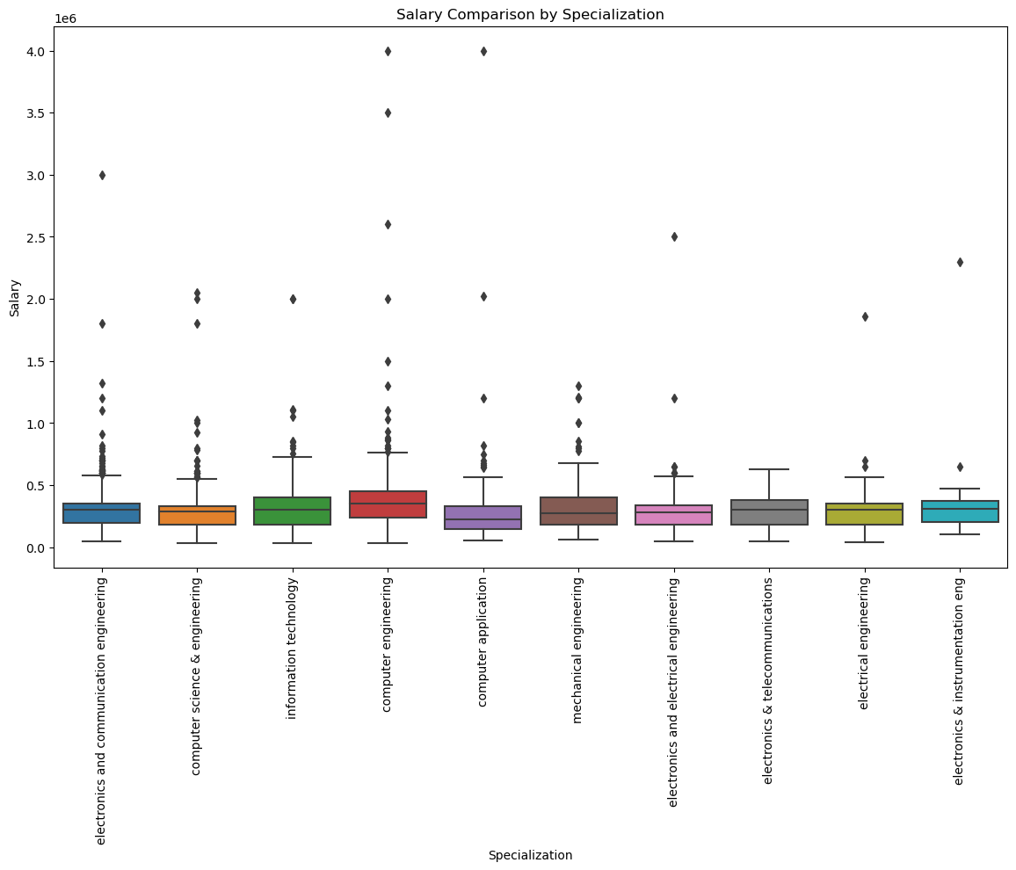
Computer Engineering students have high salaries compared to other branches

Slide 18
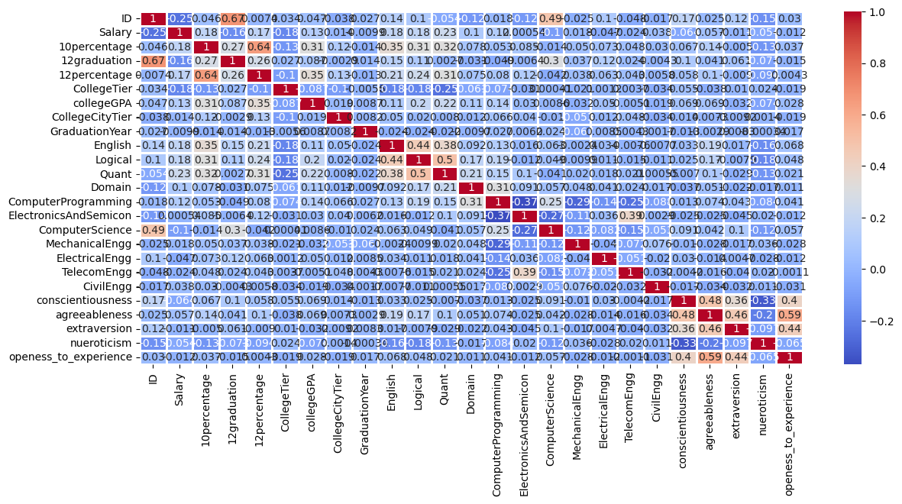

Slide 19
Conclusion: •
1.Most of Amcat Aspirants are male working in IT domain with an experience of around 5years with degree in Btech and specialization in Computer Science/Information Technology from tier-2 college in uttarpradesh with an average salary around 300k.
• 2.Highpaying jobs taken up by amcat aspirants are mostly from 'IT' Domain.
• 3.Software Engineer and Software Developer are the most aimed profession for amcat aspirants.

Slide 20
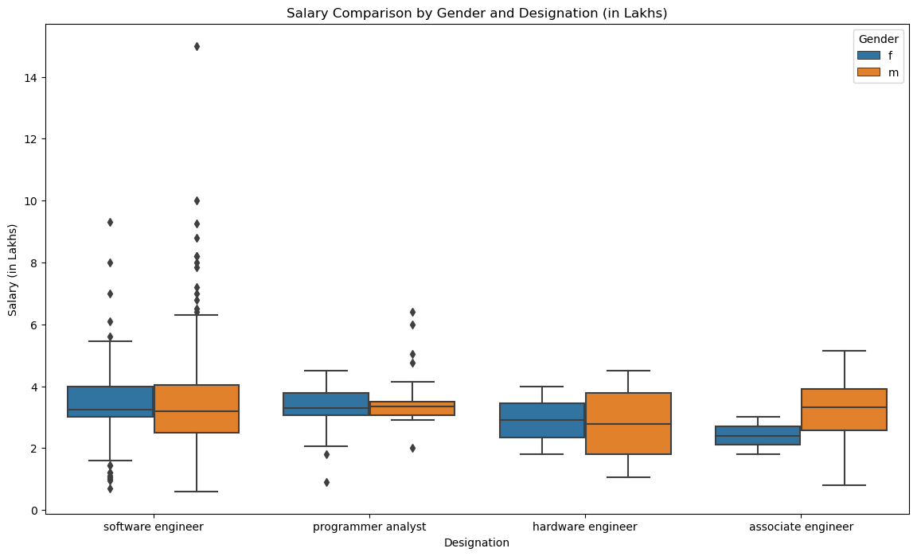
Research Question

Slide 21
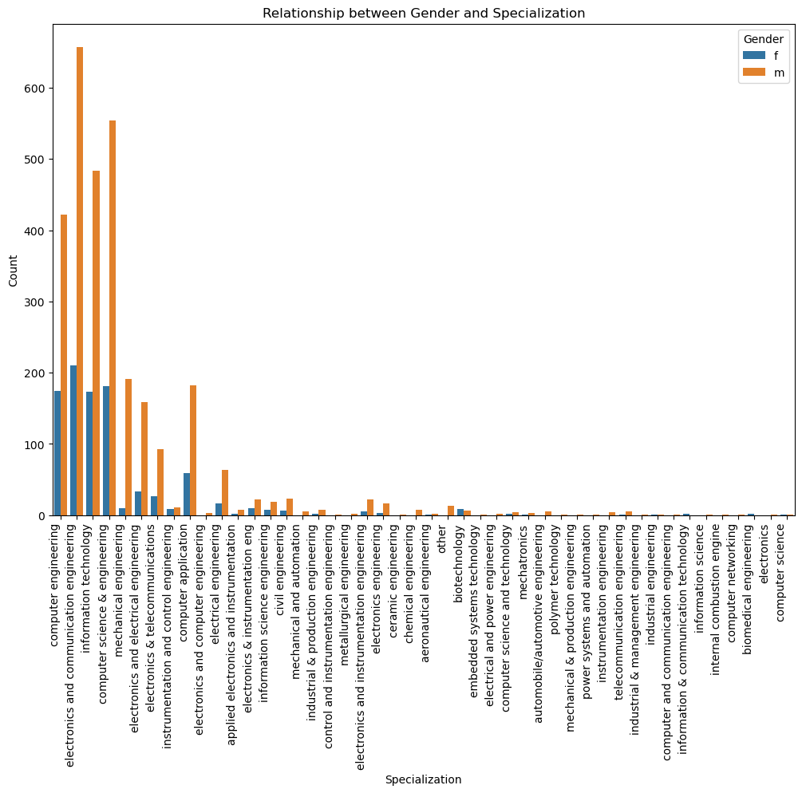

Slide 22

THANK YOU

